Slide 1
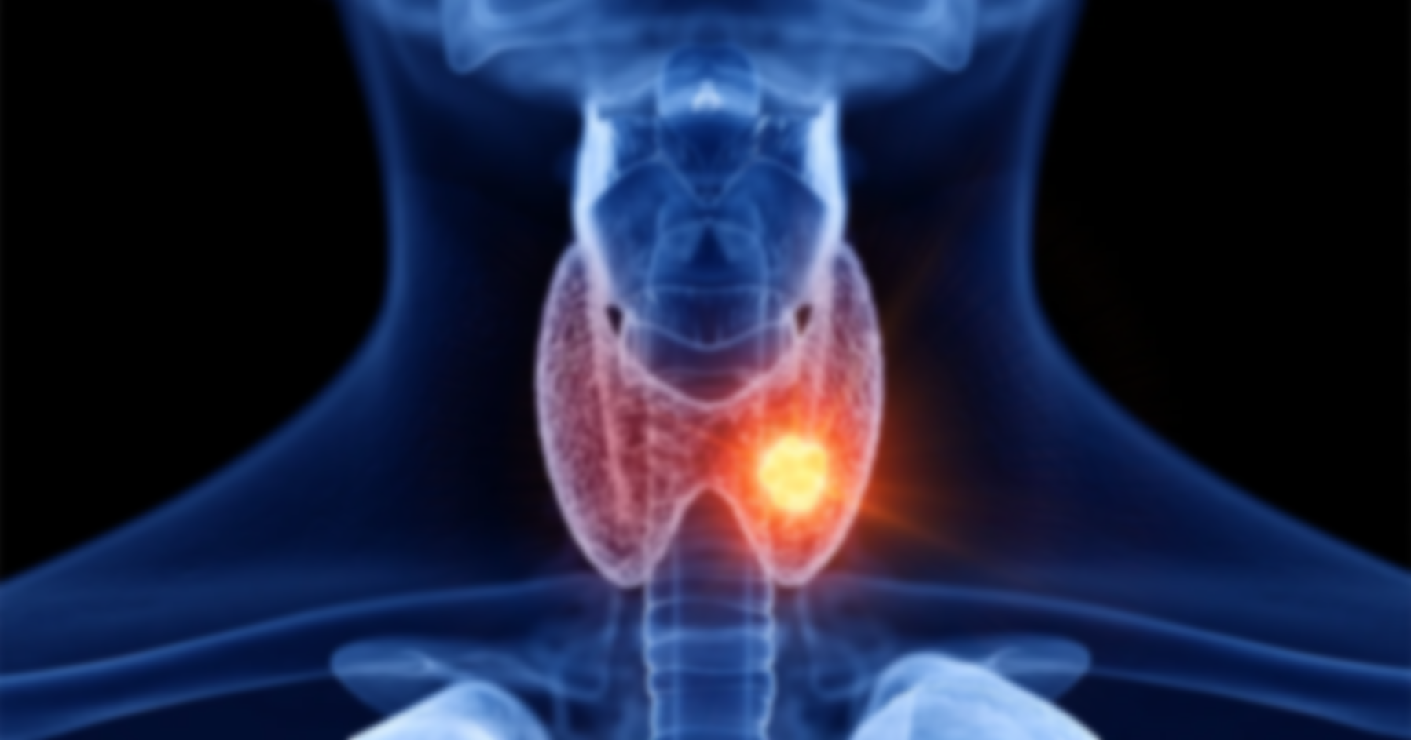

THYROID DISEASE
DETECTION
____________________
GROUPF

Slide 2
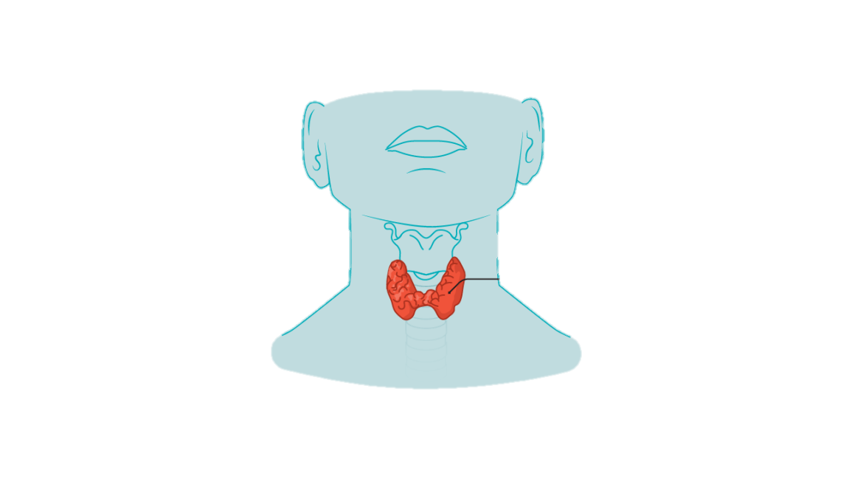
thyroid gland
Hypothyroidism
“Underactive thyroid”
Low level hormone release
Hyperthyroidism
“Overactive thyroid”
High level hormone release

Slide 3
Hypothyroidism
“Underactive thyroid”
Low level hormone release
Hyperthyroidism
“Overactive thyroid”
High level hormone release

Slide 4
PROJECT
OVERVIEW
Goal Significantly improve accuracy and efficiency of thyroid disorder detection using various Machine Learning algorithms.
Method Develop a robust classification model analyzing diverse medical data through advanced algorithms and data analytics.
Impact Assist healthcare professionals in early and accurate identification of thyroid disorders, leading to timely interventions and improved patient outcomes.

Slide 5
PROJECT WORKFLOW
Solution Flow | Choosing a Data Source | Thyroid Disease - UCI Machine Learning Repository
 | Deciding on the type of analysis | Thyroid Disorder Detection
Data Management | Data Ingestion | Importing the Dataset
 | Data Cleaning | Handling Missing Values, Treating Duplicates and Outliers
Data Analysis | Exploratory Data Analysis | Identify trends, correlation and distributions within the data
 |  | Detect Anamolies and Outliers, Understand reliability of data
 | Data Preprocessing | Feature scaling, encoding, feature engineering, dimensionality reduction
 | Mathematics Used | explaining the statistics and mathematics behind the approach
 | Modeling | creating train- test split and building a model
 | Analysis | Model testing, Tuning the parameters
 | Result & discussions | Showcase the findings
 | Conclusions | Conclude the project

Slide 6
GROUPF
PROJECT
MANAGEMENT
NAME | STUDENT ID# | ROLE
Moksh Jaiswal | 500240046 | Data Preprocessing, EDA
Alen Charuvila Saji | 500237019 | Data Preprocessing, Reporting & PPT
Adarsh Shriram Pednekar | 500233484 | Model Deployment
Utsav Harshadbhai Khamar | 500238367 | Data Preprocessing & Model Deployment
Pranay Sai Jangeti | 500240045 | Reporting and Documentation
Aravind Seenivasan | 500236355 | Introduction and Model Building
Taranjot Singh Bindra | 500239542 | EDA and Model Building
Tanzima Mohammadyasin Shaikh | 500238212 | Model Deployment & Conclusions
Smit Rajendraprasad Patel | 500238279 | Model Building
Om Kiranbhai Patel | 500228172 | Model Deployment & Conclusions

Slide 7

DATASET OVERVIEW
9172 Records (observations) from 1984 to early 1987.
31 Attributes (Demographic information, Medical history, etc. )
Record format : (31 attribute values), diagnoses [record identification]
Source : -
UCI Machine Learning Repository and made available on Kaggle.
Thyroid disease records supplied by the Garavan Institute and J. Ross Quinlan, New South Wales Institute, Syndney, Australia,1987.
Modified by Goldstein Markus et al. in 2015 for “unsupervised anomaly detection”.

Slide 8

31 Attributes
Demographic information
Medical history
Laboratory test results
Others

Slide 9

31 Attributes
Demographic information
Medical history
Laboratory test results
Others
- Age : The age of the patient (integer).
- Sex : Gender identification of the patient (string)

Slide 10

31 Attributes
Demographic information
Medical history
- On_thyroxine: Boolean indicating whether the patient is on thyroxine.
- Lithium: Boolean indicating whether the patient uses lithium.
- Query_on_thyroxine: Boolean indicating queries regarding thyroxine usage.
- Query_hypothyroid: Boolean indicating the patient's belief of having hypothyroidism.
- On_antithyroid_meds: Boolean indicating whether the patient is on antithyroid medications.
- I131_treatment: Boolean indicating whether the patient is undergoing I131 treatment.
- Sick: Boolean indicating whether the patient is sick.
- Pregnant: Boolean indicating whether the patient is pregnant.
- Thyroid_surgery: Boolean indicating whether the patient has undergone thyroid surgery.
- Goitre: Boolean indicating whether the patient has goitre.
- Tumor: Boolean indicating whether the patient has a tumor.
- Hypopituitary: Float value indicating a condition related to the hyperpituitary gland.
- Psych: Boolean indicating a psychological condition.

Slide 11
31 Attributes
Demographic information
Medical history
- On_thyroxine: Boolean indicating whether the patient is on thyroxine.
- Lithium: Boolean indicating whether the patient uses lithium.
- Query_on_thyroxine: Boolean indicating queries regarding thyroxine usage.
- Query_hypothyroid: Boolean indicating the patient's belief of having hypothyroidism.
- On_antithyroid_meds: Boolean indicating whether the patient is on antithyroid medications.
- I131_treatment: Boolean indicating whether the patient is undergoing I131 treatment.
- Sick: Boolean indicating whether the patient is sick.
- Pregnant: Boolean indicating whether the patient is pregnant.
- Thyroid_surgery: Boolean indicating whether the patient has undergone thyroid surgery.
- Goitre: Boolean indicating whether the patient has goitre.
- Tumor: Boolean indicating whether the patient has a tumor.
- Hypopituitary: Float value indicating a condition related to the hyperpituitary gland.
- Psych: Boolean indicating a psychological condition.

Slide 12

31 Attributes
Medical history
Laboratory test results
- TSH: Float value representing the TSH level in the blood.
- T3: Float value representing the T3 level in the blood.
- TT4: Float value representing the TT4 level in the blood.
- T4U: Float value representing the T4U level in the blood.
- FTI: Float value representing the FTI level in the blood.
- TBG: Float value representing the TBG level in the blood.
- TSH_measured: Boolean indicating whether TSH was measured.
- T3_measured: Boolean indicating whether T3 was measured.
- TT4_measured: Boolean indicating whether TT4 was measured.
- T4U_measured: Boolean indicating whether T4U was measured.
- FTI_measured: Boolean indicating whether FTI was measured.
- TBG_measured: Boolean indicating whether TBG was measured.

Slide 13
31 Attributes
Medical history
Laboratory test results
- TSH: Float value representing the TSH level in the blood.
- T3: Float value representing the T3 level in the blood.
- TT4: Float value representing the TT4 level in the blood.
- T4U: Float value representing the T4U level in the blood.
- FTI: Float value representing the FTI level in the blood.
- TBG: Float value representing the TBG level in the blood.
- TSH_measured: Boolean indicating whether TSH was measured.
- T3_measured: Boolean indicating whether T3 was measured.
- TT4_measured: Boolean indicating whether TT4 was measured.
- T4U_measured: Boolean indicating whether T4U was measured.
- FTI_measured: Boolean indicating whether FTI was measured.
- TBG_measured: Boolean indicating whether TBG was measured.

Slide 14

31 Attributes
Demographic information
Medical history
Laboratory test results
Others
- Referral_source: String indicating the source of patient referral.
- Target: String indicating the medical diagnosis of hyperthyroidism.
- Patient_id: String representing a unique identifier for each patient.

Slide 15

Data summary
Primary emphasis on Multi-classification
Attributes Variety
Boolean and Numeric Variables
Target Variable
Patient Identifier
Referral Source

Slide 16
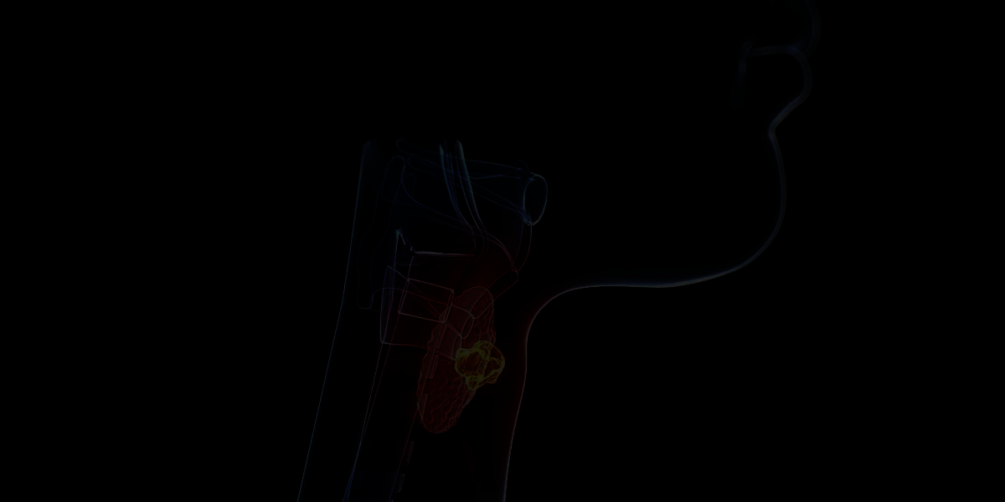
DataCleaning

Slide 17
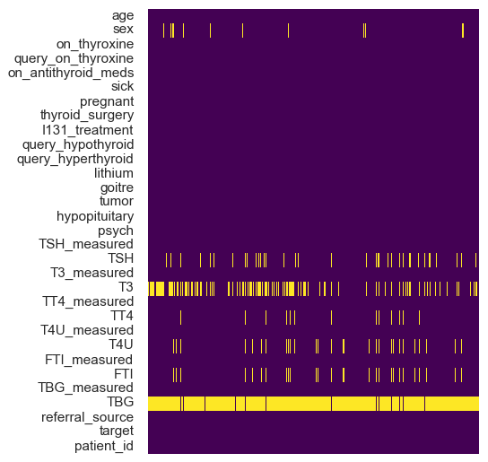
DataCleaning
No Duplicates
Heatmap – Null values
Missing at Random (MAR)
Missing Not at Random (MNAR)

Slide 18
DataCleaning
No Duplicates
Heatmap – Null values
Missing at Random (MAR)
Missing Not at Random (MNAR)

Slide 19
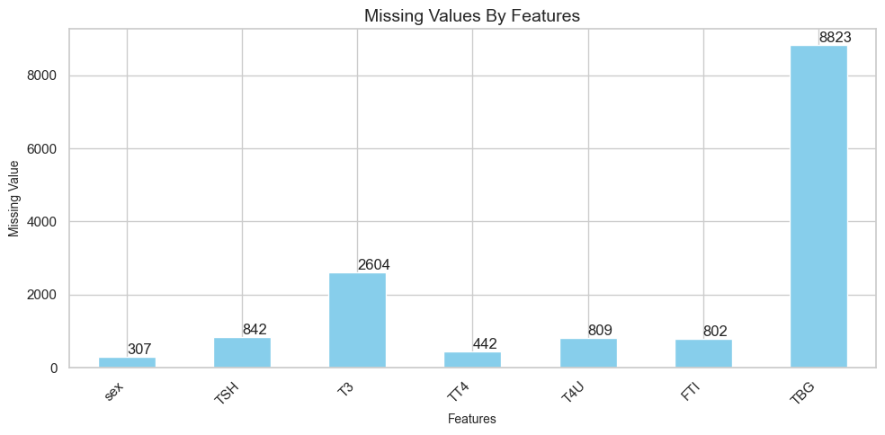
DataCleaning

Slide 20
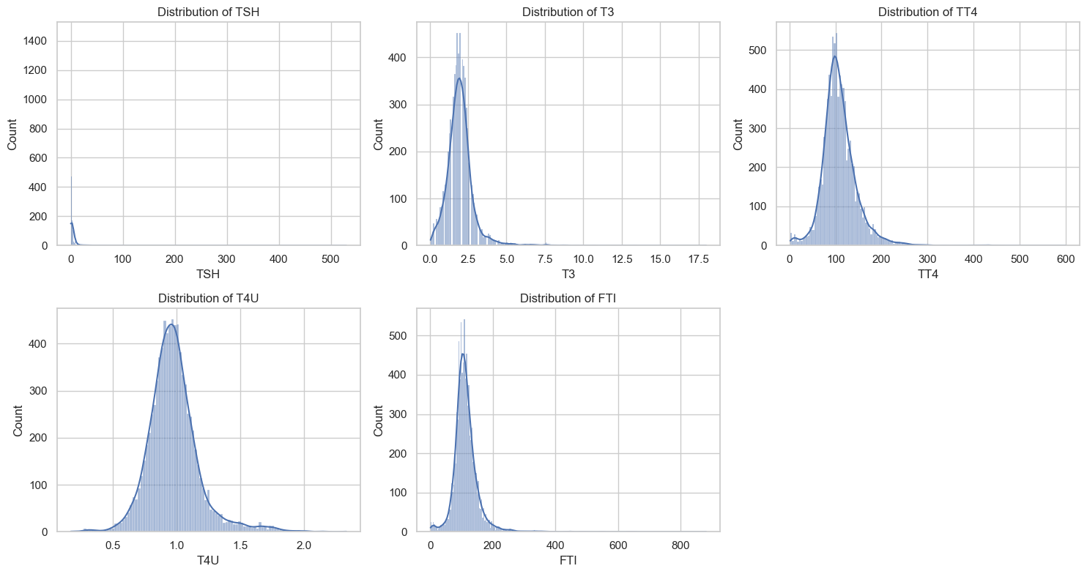
DataCleaning |Distribution

Slide 21
DataCleaning |Distribution
T4U
TSH
Heavily right-skewed, with the majority of values clustered below 5 mU/L.
few outliers exist - very high TSH levels.
Roughly normal, centered around 0.9.
The spread is relatively narrow, similar to T3.
TT4
Slightly right-skewed, with most values falling between 80 and 120 ng/dL.
T3
Approximately normal, centered around 1.5 ng/dL.
The spread is relatively narrow, suggesting most individuals have T3 levels within a typical range.
Few outliers exists - very low or high T3 levels.
FTI
Slightly right-skewed, mirroring the TT4 distribution.
Most values - 100 >= 140.

Slide 22
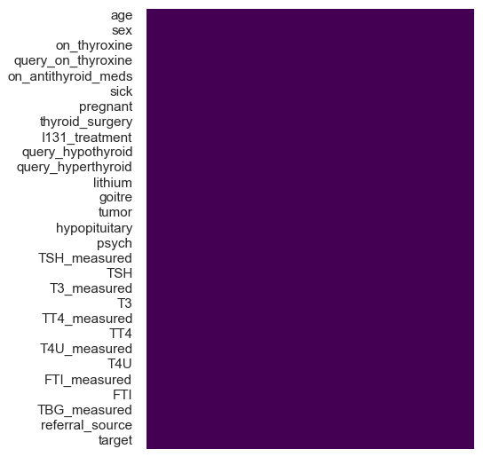
DataCleaning |Outcome
Dropped features
TBG , patient_id
Handled Missing values
Mean: T3, T4U
Mode: Sex
Median: TSH, TT4, FTI

Slide 23
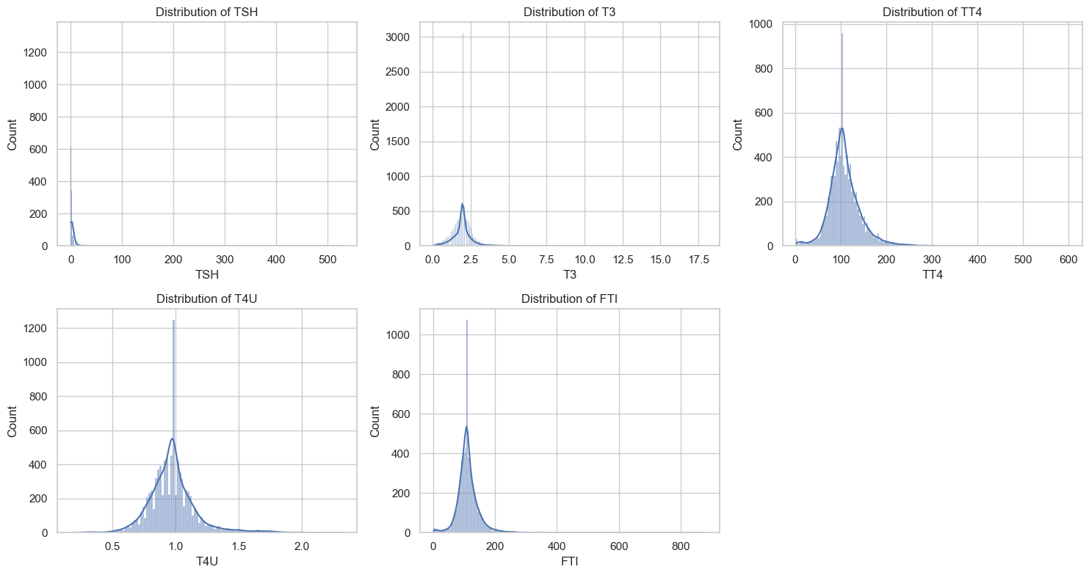
Data Cleaning |Outcome

Slide 24

Exploratory Data Analysis

Slide 25
Exploratory Data Analysis
Outlier Detection
Age – Max. value of 65526 years & a Min. value of 1 year.
3 Sigma rule – Normally distributed (roughly)
7368 × 29

Slide 26
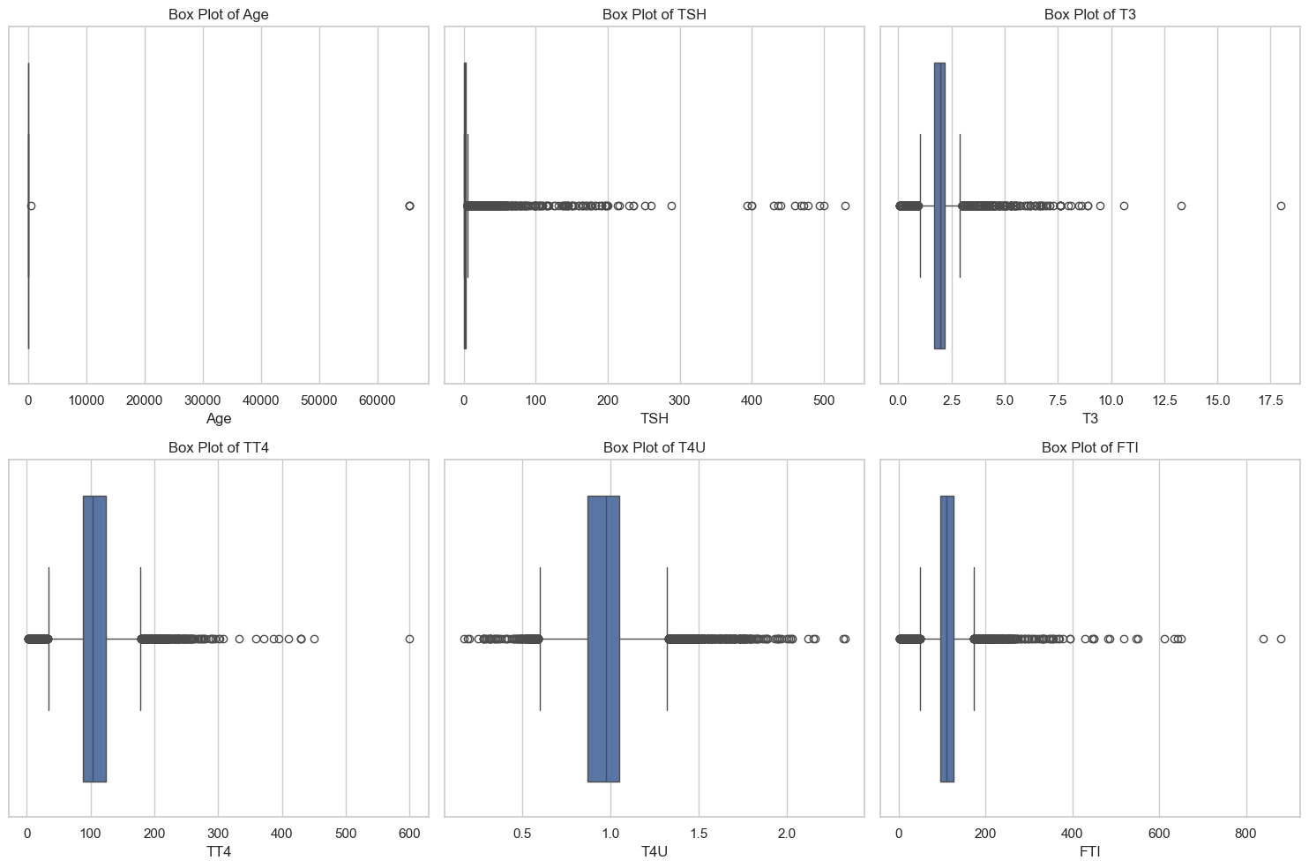
Exploratory Data Analysis

Slide 27
"-" indicates no condition requiring comment.
"X|Y" is interpreted as "consistent with X, but more likely Y".
Letter Diagnosis
------ ---------
hyperthyroid conditions:
A hyperthyroid
B T3 toxic
C toxic goitre
D secondary toxic
hypothyroid conditions:
E hypothyroid
F primary hypothyroid
Exploratory Data Analysis

Slide 28
G compensated hypothyroid
H secondary hypothyroid
binding protein:
I increased binding protein
J decreased binding protein
general health:
K concurrent non-thyroidal illness
replacement therapy:
L consistent with replacement therapy
M underreplaced

Slide 29
N overreplaced
antithyroid treatment:
O antithyroid drugs
P I131 treatment
Q surgery
miscellaneous:
R discordant assay results
S elevated TBG
T elevated thyroid hormones

Slide 30
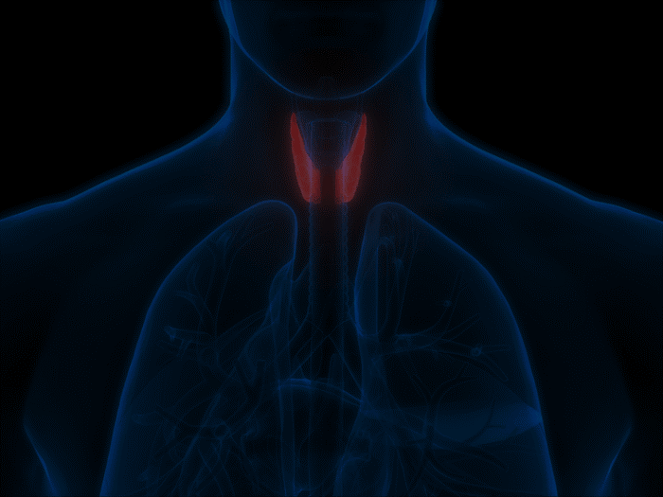
DataVisualisation

Slide 31
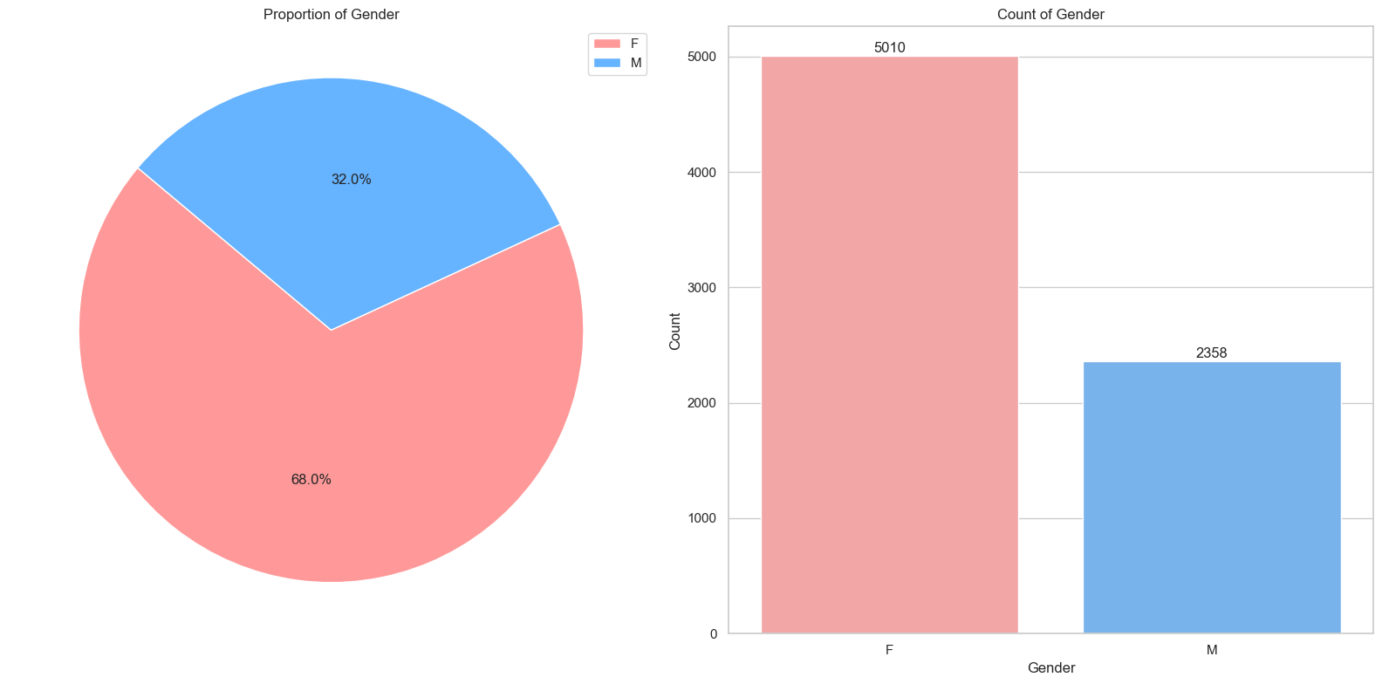
Data Visualisation

Slide 32
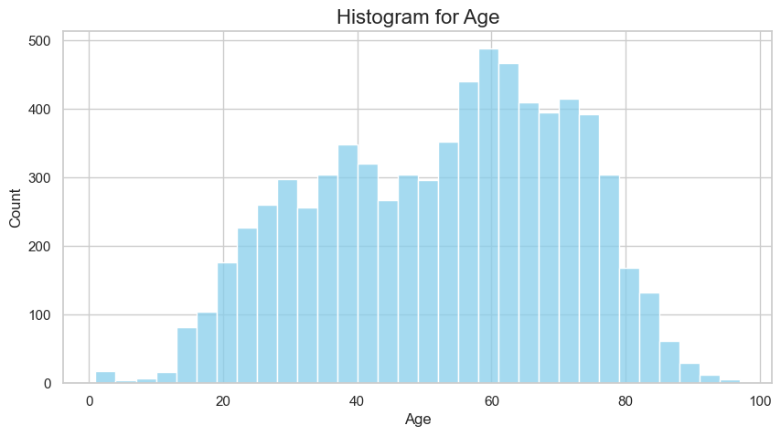
Data Visualisation

Slide 33
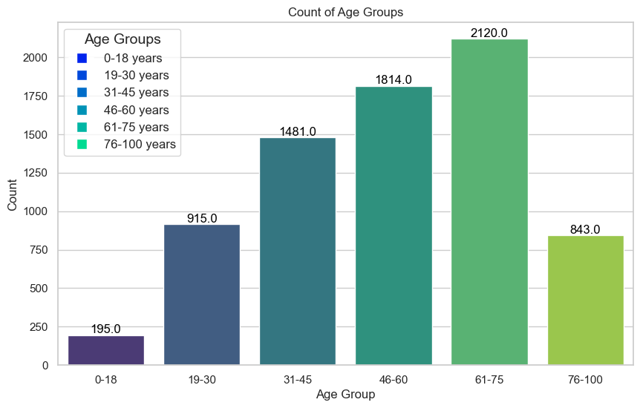
Data Visualisation

Slide 34
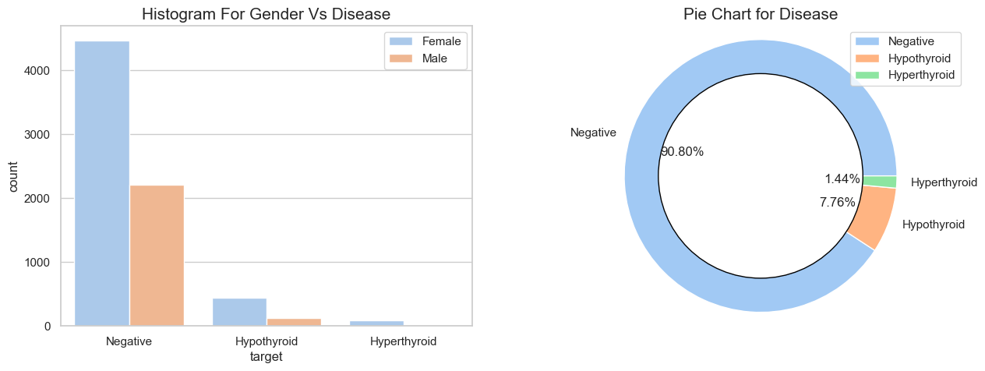
Data Visualisation

Slide 35
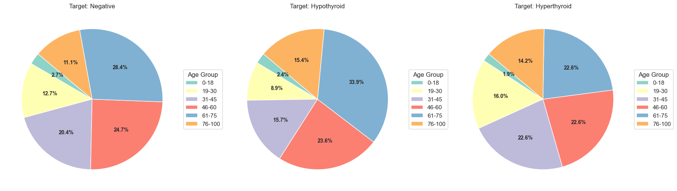
Data Visualisation

Slide 36
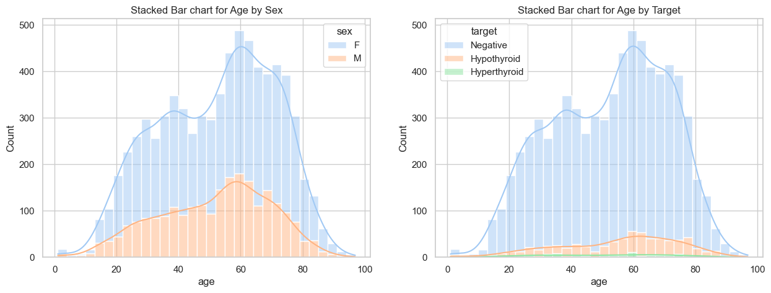
Data Visualisation

Slide 37
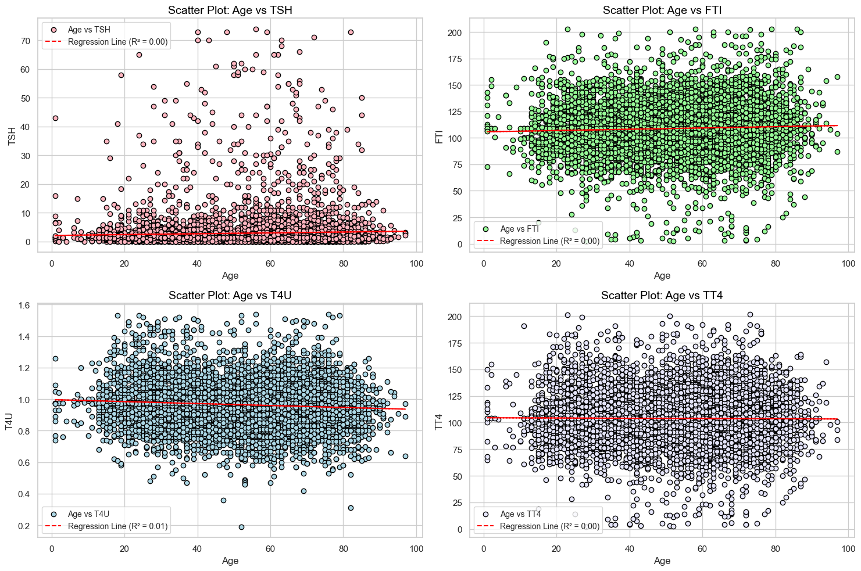

Slide 38
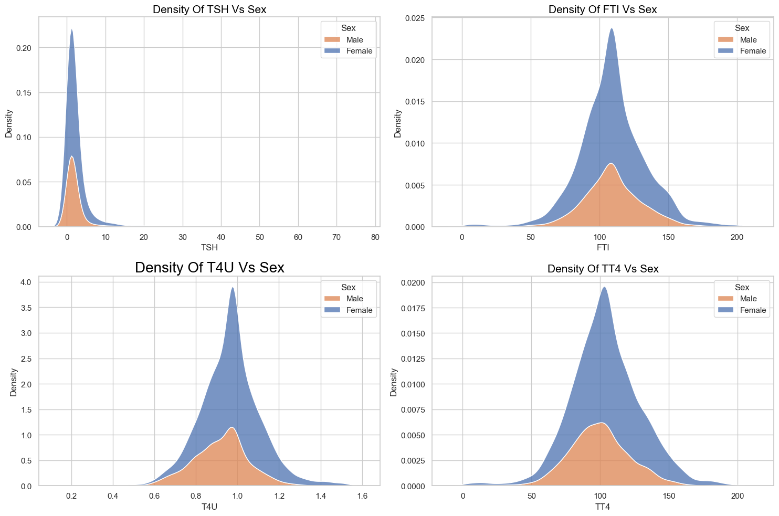

Slide 39
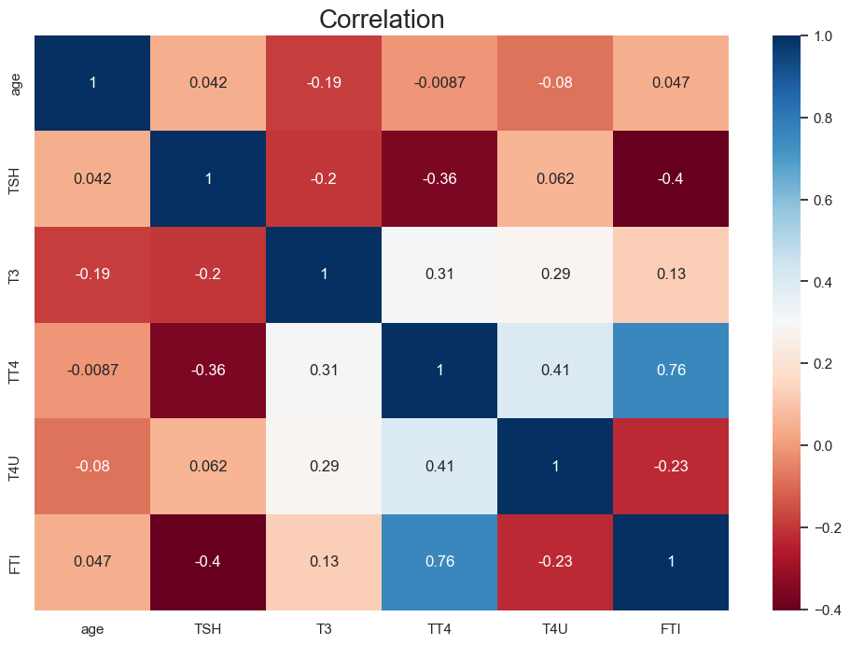

Slide 40
THYROID DISEASE
DETECTION
____________________
GROUPF

Slide 41
PROJECT
OVERVIEW
Goal Significantly improve accuracy and efficiency of thyroid disorder detection using various Machine Learning algorithms.
Method Develop a robust classification model analyzing diverse medical data through advanced algorithms and data analytics.
Impact Assist healthcare professionals in early and accurate identification of thyroid disorders, leading to timely interventions and improved patient outcomes.

Slide 42
PROJECT WORKFLOW
Solution Flow | Choosing a Data Source | Thyroid Disease - UCI Machine Learning Repository
 | Deciding on the type of analysis | Thyroid Disorder Detection
Data Management | Data Ingestion | Importing the Dataset
 | Data Cleaning | Handling Missing Values, Treating Duplicates and Outliers
Data Analysis | Exploratory Data Analysis | Identify trends, correlation and distributions within the data
 |  | Detect Anomalies and Outliers, Understand reliability of data
 | Data Preprocessing | Feature scaling, encoding, feature engineering, dimensionality reduction
 | Mathematics Used | Explaining the statistics and mathematics behind the approach
 | Modelling | Creating train- test split and building a model
 | Analysis | Model testing, Tuning the parameters
 | Result & discussions | Showcase the findings
 | Conclusions | Conclude the project

Slide 43
PROJECT WORKFLOW
Solution Flow | Choosing a Data Source | Thyroid Disease - UCI Machine Learning Repository
 | Deciding on the type of analysis | Thyroid Disorder Detection
Data Management | Data Ingestion | Importing the Dataset
 | Data Cleaning | Handling Missing Values, Treating Duplicates and Outliers
Data Analysis | Exploratory Data Analysis | Identify trends, correlation and distributions within the data
 |  | Detect Anomalies and Outliers, Understand reliability of data
 | Data Preprocessing | Feature scaling, encoding, feature engineering, dimensionality reduction
 | Mathematics Used | Explaining the statistics and mathematics behind the approach
 | Modelling | Creating train- test split and building a model
 | Analysis | Model testing, Tuning the parameters
 | Result & discussions | Showcase the findings
 | Conclusions | Conclude the project

Slide 44
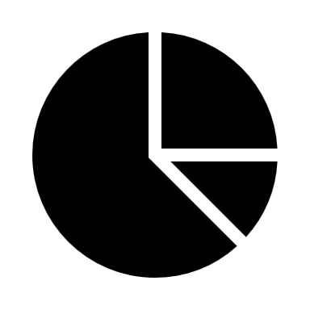
Data Leakage

Slide 45

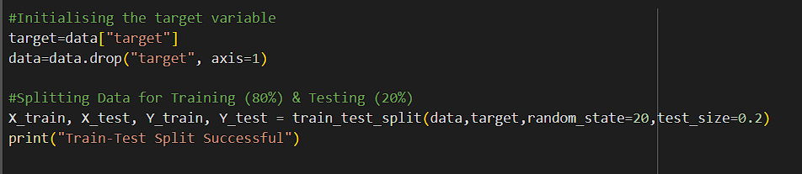
Data Splitting
Train – 80% , Test – 20%
train_test_split()

Slide 46
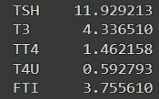

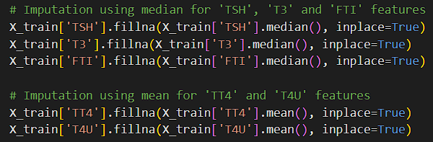
Null Value Imputation
“Sex” = mode()
Skewness
Median(), Mean()

Slide 47

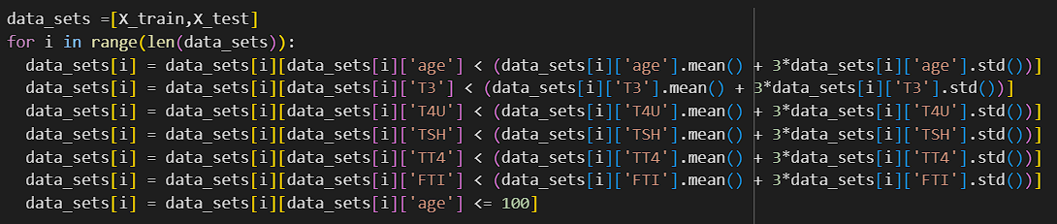
Outlier Treatment
Distribution – Roughly Normal
3σ rule
(Q1 - 1.5 IQR and Q3 + 1.5 IQR)

Slide 48
Outlier Treatment
Distribution – Roughly Normal
3σ rule
[ Q1 - 1.5 IQR, Q3 + 1.5 IQR ]

Slide 49

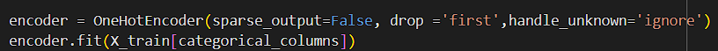
DataTransformation
Categorical values
['sex', 'on_thyroxine', 'query_on_thyroxine', 'on_antithyroid_meds', 'sick', 'pregnant', 'thyroid_surgery', 'I131_treatment', 'query_hypothyroid', 'query_hyperthyroid', 'lithium', 'goitre', 'tumor', 'hypopituitary', 'psych', 'TSH_measured', 'T3_measured', 'TT4_measured', 'T4U_measured', 'FTI_measured', 'TBG_measured', 'referral_source']
One-Hot Encoding

Slide 50
DataTransformation
Categorical values
['sex', 'on_thyroxine', 'query_on_thyroxine', 'on_antithyroid_meds', 'sick', 'pregnant', 'thyroid_surgery', 'I131_treatment', 'query_hypothyroid', 'query_hyperthyroid', 'lithium', 'goitre', 'tumor', 'hypopituitary', 'psych', 'TSH_measured', 'T3_measured', 'TT4_measured', 'T4U_measured', 'FTI_measured', 'TBG_measured', 'referral_source']
One-Hot Encoding

Slide 51

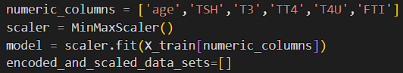
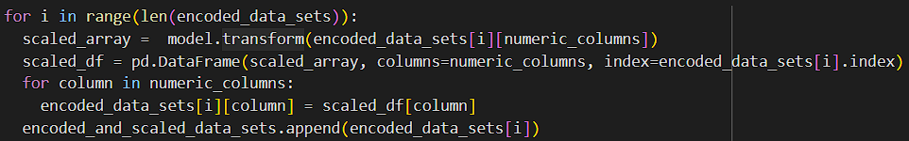
FeatureScaling
Numerical values
MinMaxScaler()

Slide 52
THYROID DISEASE
DETECTION
____________
THANK YOU

Slide 53
THYROID DISEASE
DETECTION
____________________
GROUPF

Slide 54
PROJECT
OVERVIEW
Goal Significantly improve accuracy and efficiency of thyroid disorder detection using various Machine Learning algorithms.
Method Develop a robust classification model analyzing diverse medical data through advanced algorithms and data analytics.
Impact Assist healthcare professionals in early and accurate identification of thyroid disorders, leading to timely interventions and improved patient outcomes.

Slide 55
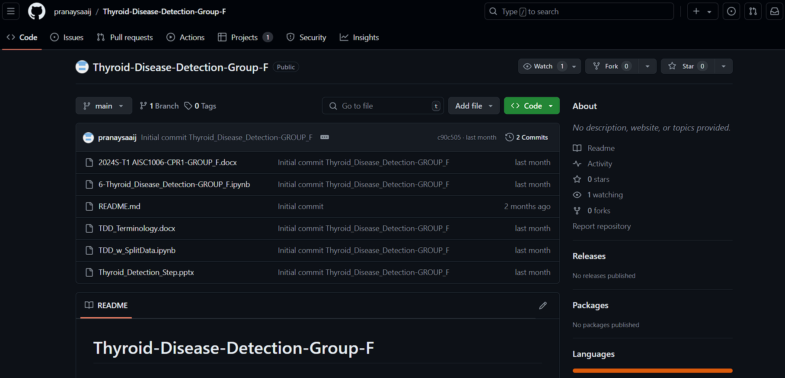
GitHub

Slide 56
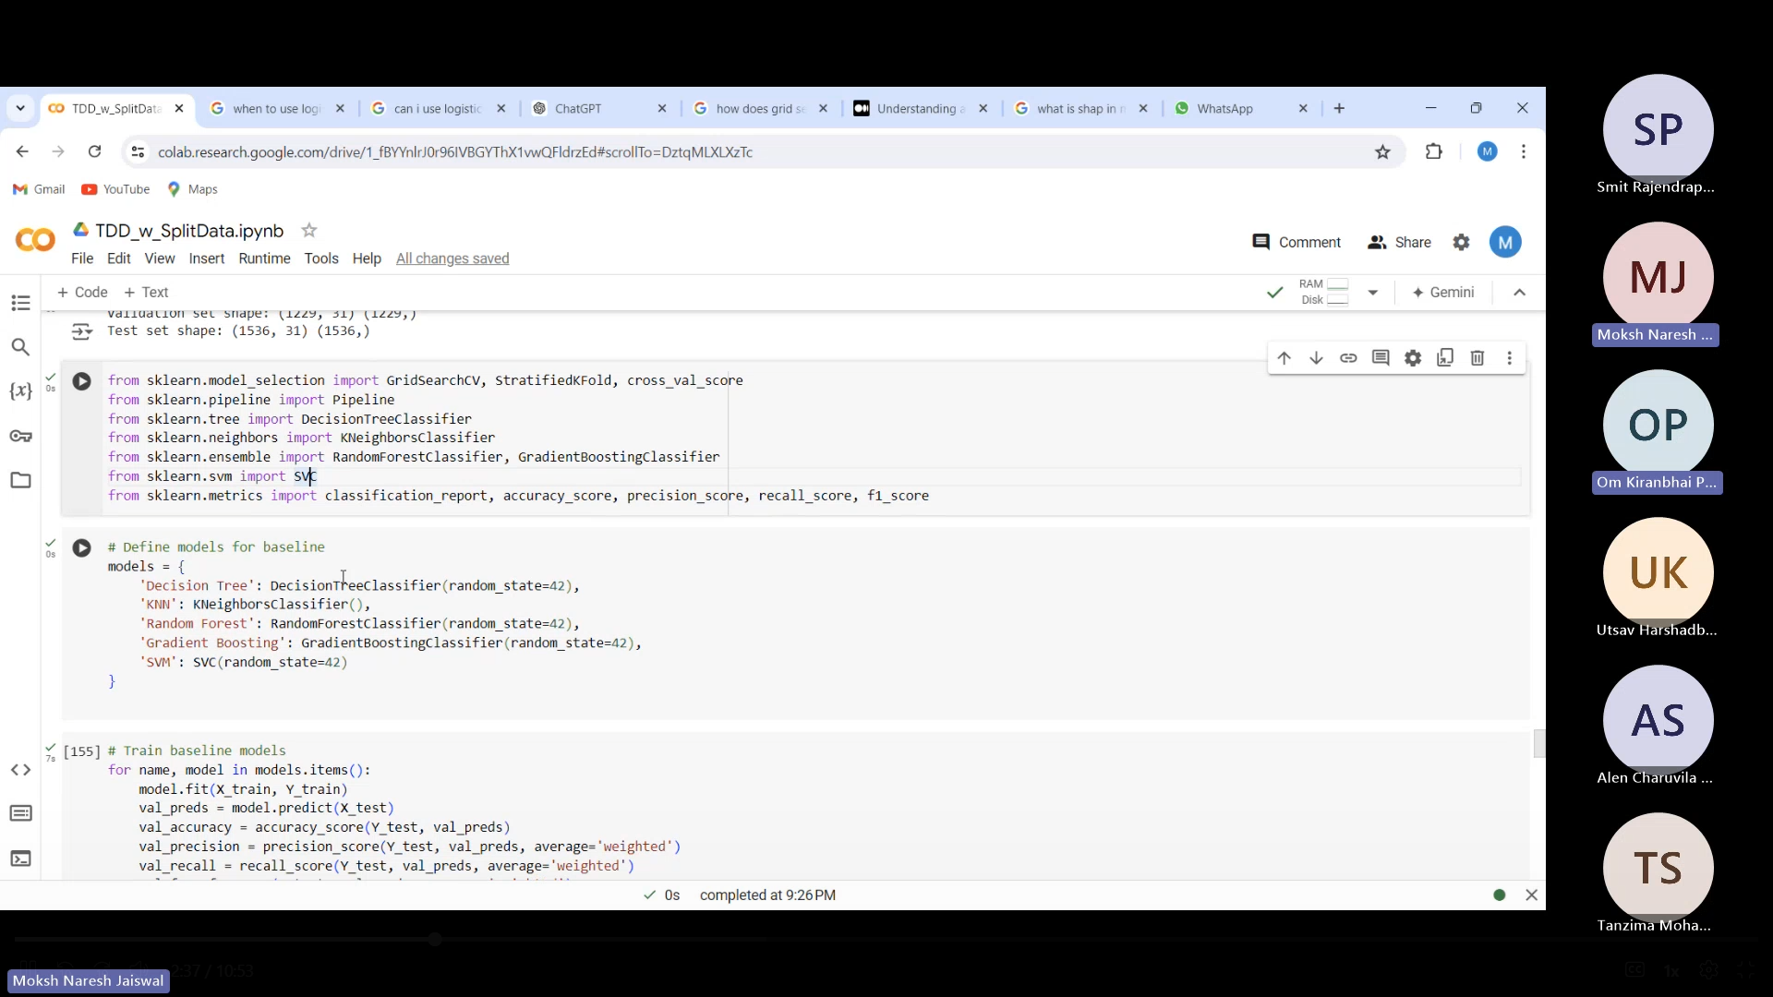
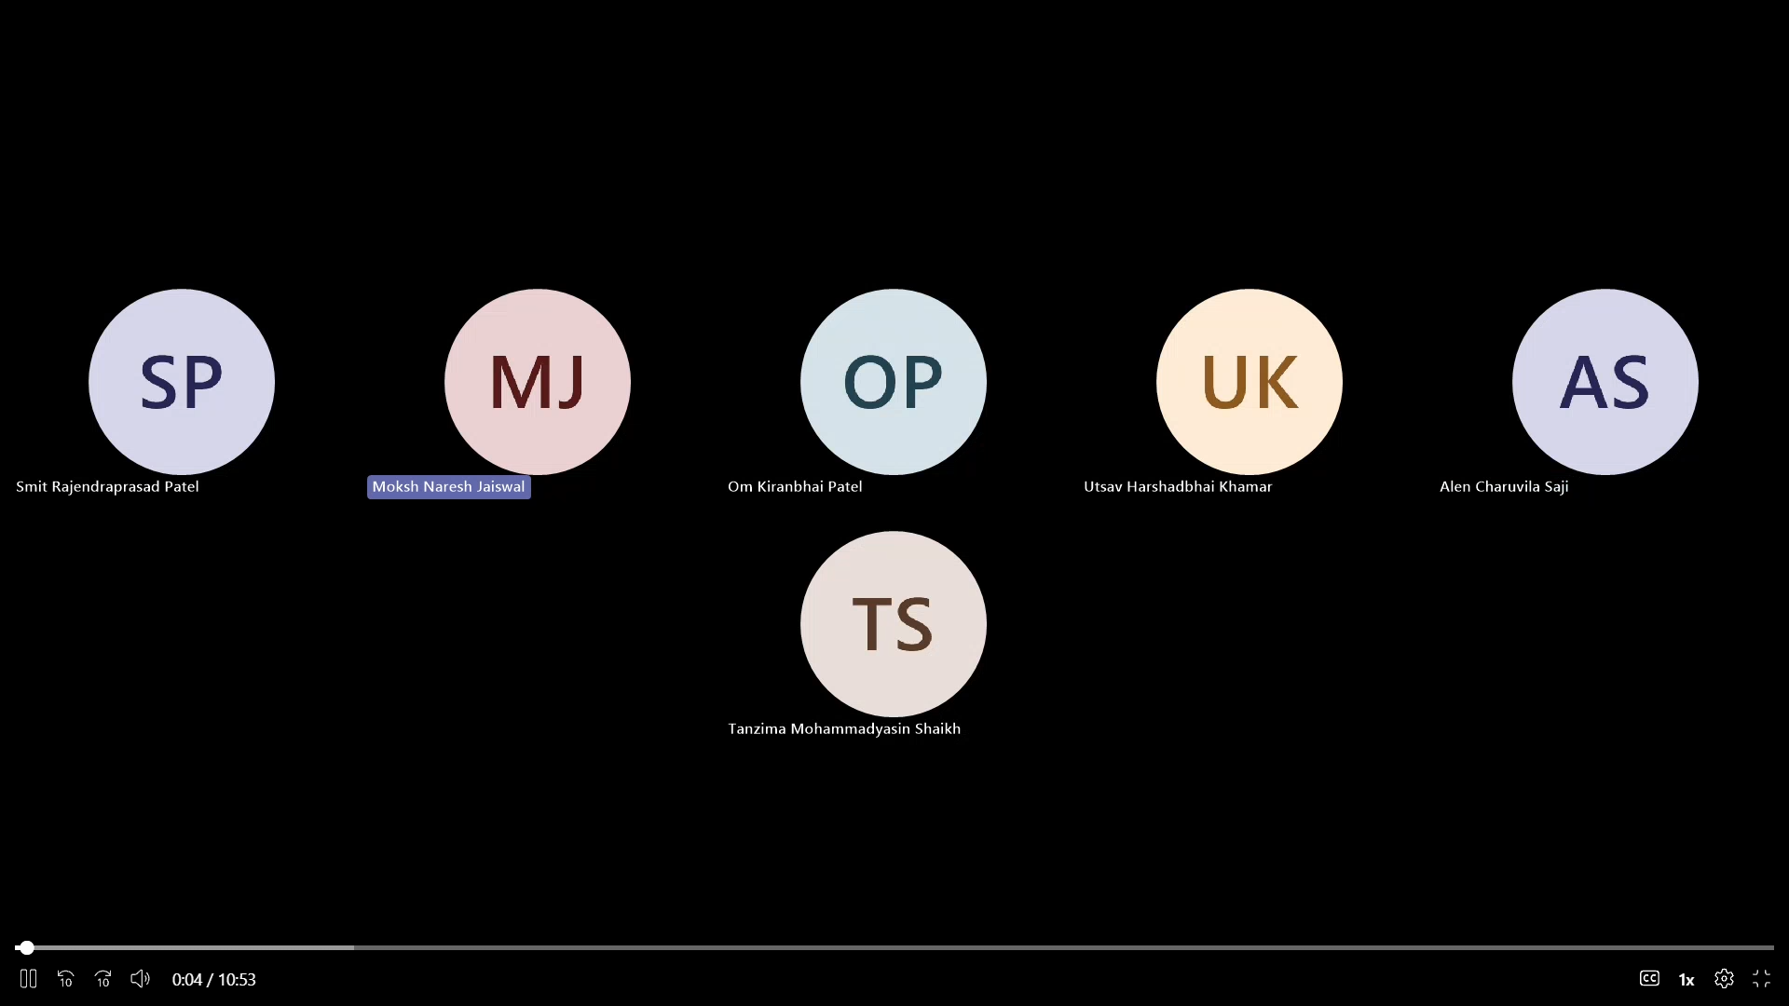
Project Management

Slide 57
Data Splitting
train_test_split()
Train – 80% , Test – 20%

Slide 58
Data Splitting
train_test_split()
Train – 80% | Validation – 20%

Slide 59
ModelBuilding
‘Decision Tree'
'KNN’
'Random Forest’
'Gradient Boosting’
'SVM'

Slide 60
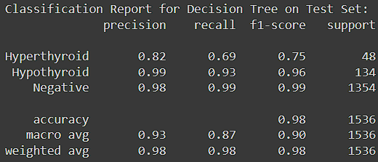
Model|Building
Decision Tree
Performance:
Accuracy : 0.9785
Precision : 0.9778
Recall : 0.9785
F1 Score : 0.9778

Slide 61
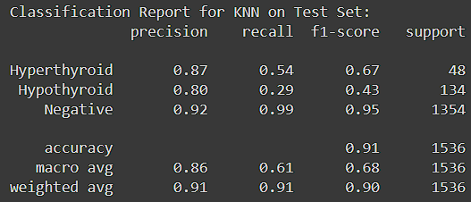
Model|Building
KNN
Performance:
Accuracy : 0.9147
Precision : 0.9072
Recall : 0.9147
F1 Score : 0.8984

Slide 62
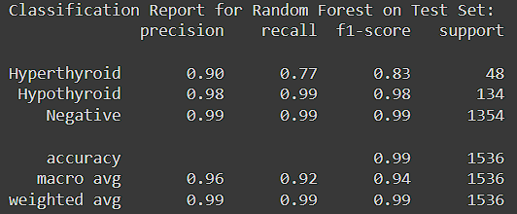
Model|Building
Random Forest
Performance:
Accuracy : 0.9870
Precision : 0.9866
Recall : 0.9870
F1 Score : 0.9866

Slide 63
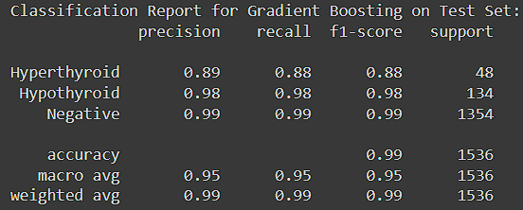
Model|Building
Gradient Boosting
Performance:
Accuracy : 0.9889
Precision : 0.9889
Recall : 0.9889
F1 Score : 0.9889

Slide 64
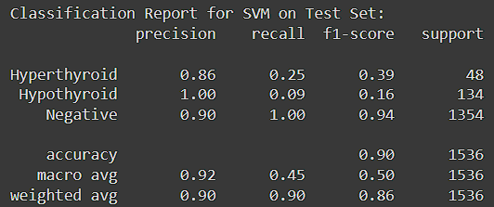
Model|Building
SVM
Performance:
Accuracy : 0.8958
Precision : 0.9033
Recall : 0.8958
F1 Score : 0.8587

Slide 65
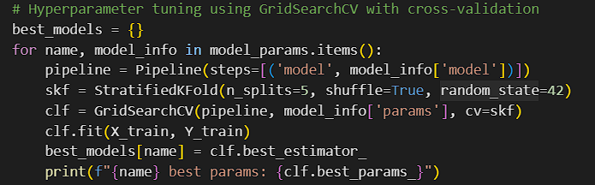
Model|Building
Hyperparameter Tuning
GridSearchCV
K-Fold (StratifiedKFold)

Slide 66
Model|Building
Results
Decision Tree
- Validation Accuracy: 0.9772
- Test Accuracy: 0.9863
- Precision and Recall: Balanced performance across all classes (Hyperthyroid, Hypothyroid, Negative).
- Observation: Shows good generalization with minimal signs of overfitting based on validation results.

Slide 67
Model|Building
KNN
- Validation Accuracy : 0.9243
- Test Accuracy : 0.9154
- Precision and Recall : Lower performance on Hyperthyroid and Hypothyroid classes compared to Decision Tree and other models.
- Observation: Shows signs of underfitting, especially for minority classes (Hyperthyroid, Hypothyroid).

Slide 68
Model|Building
Random Forest
- Validation Accuracy : 0.9821
- Test Accuracy : 0.9863
- Precision and Recall : High performance across all classes, similar to Decision Tree.
- Observation: Slightly better than Decision Tree in terms of generalization and robustness

Slide 69
Model|Building
Gradient Boosting
- Validation Accuracy : 0.9797
- Test Accuracy : 0.9889
- Precision and Recall : High performance across all classes, comparable to Random Forest
- Observation: Similar to Random Forest in terms of performance but may require more computational resources.

Slide 70
Model|Building
SVM
- Validation Accuracy : 0.9373
- Test Accuracy : 0.9362
- Precision and Recall : Good performance on Negative class but lower on Hyperthyroid and Hypothyroid classes.
- Observation: Shows signs of underfitting for minority classes and may benefit from additional tuning

Slide 71
Model|Building
Cross-Validation Accuracy:
Random Forest : 0.9853 (+/- 0.0033)
Gradient Boosting : 0.9837 (+/- 0.0036)

Slide 72
Model|Building
Random Forest
Model Complexity : Handles high-dimensional data well and is less prone to overfitting
Training and Inference Speed : Faster Training , Interpretability handles high-dimensional data well and is less prone to overfitting.
Computationally inexpensive

Slide 73
THYROID DISEASE
DETECTION
____________
THANK YOU

